Slide 1
TETRIS game
Parul Institute of Computer Applications
Semester 2 Project -1
2022-23
Team members
1. 2205101100152 Dipesh Rauniyar Division: G
2. 2205101100103 Raghav Mahajan Division: G
3. 2205101100157 Kunal Yadav Division: G

Slide 2
INDEX
Abstract
Tools and Technology Used
Features of Proposed System
Limitation of Proposed System
Users and their role description

Slide 3
Abstract
This project aims to develop a modern interpretation of the classic Tetris game, leveraging contemporary game development technologies and design principles. Tetris, originally conceived as a simple yet challenging puzzle game, has evolved into a cultural phenomenon since its inception. The objective of this project is to honor its legacy while introducing new features and enhancements that cater to today’s gaming audience.
The game offers multiple levels of difficulty, word categories, and game modes to cater to the diverse needs and preferences of the users. The game's hint system, high score tracking, and user profiles provide motivation and feedback to the users, keeping them engaged and challenged.

Slide 4
Tools and Technology Used
Python programming language: Python will be employed for its simplicity, readability, and suitability for rapid prototyping in game development. Python's versatility and extensive libraries make it ideal for implementing game logic and mechanics efficiently.
Pygame Library: Pygame, a set of Python modules designed for writing video games, will be utilized for handling graphics, sound, and user input. Pygame provides a straightforward API for 2D game development, making it suitable for implementing Tetris' visual and interactive elements.
Integrated Development Environment (IDE): Visual Studio Code (VS Code) or PyCharm will be used as the primary IDE for development. These IDEs offer robust features such as code debugging, syntax highlighting, and integration with version control systems, essential for collaborative and efficient development.
Database Management System: A database management system can be used to store and manage game data, such as player scores, game progress, and high scores.
Git Hub: It is simply used for group contribution for the Tetris game system.

Slide 5
Features of Proposed System
Classic Gameplay Mechanics: Implementing the core mechanics of Tetris, including block manipulation (moving and rotating Tetrominoes ), line clearing, scoring, and level progression.: Data of the player or user is saved from registration page to use it as user authentication while logging to the game.
Multiple Game Modes: Offering various game modes such as classic endless mode, timed mode, and possibly multiplayer modes for competitive play.
Scoring and Leaderboards: Tracking and displaying scores locally and possibly online, allowing players to compete for high scores and achievements.
Pause and Resume: Allowing players to pause the game at any time and resume from where they left off, with an option to restart or quit.

Slide 6
Limitation of Proposed System
Graphics Complexity: While aiming for modern visual design, constraints in graphical resources or development time may limit the complexity and richness of visual elements compared to AAA games.
Lack of Sound Effects and Visuals: The Tetris game project may lack engaging sound effects or visually appealing graphics, which could limit the user's engagement and enjoyment of the game.
Difficulty Level may not be Appropriate for all Users: The game's difficulty level might be too high for some users, which could lead to frustration and a lack of motivation to continue playing. At the same time, the difficulty level may be too easy for more advanced users, which could limit the challenge and entertainment value of the game.

Slide 7
Accessibility Challenges: Despite efforts, achieving comprehensive accessibility features (e.g., for players with disabilities) may require additional resources or expertise not fully addressed in the initial development phase.
User Interface (UI) Consistency: Ensuring a cohesive and intuitive user interface across different platforms and screen sizes may pose challenges, impacting user experience and accessibility.

Slide 8
Users and their role description
User/Player
Description: The primary user role who interacts directly with the game through controls (keyboard, touch input, etc.) to manipulate falling Tetrominoes.
Role: Plays the game to achieve high scores by clearing lines and advancing through levels, aiming for continuous gameplay and improvement.

Slide 9
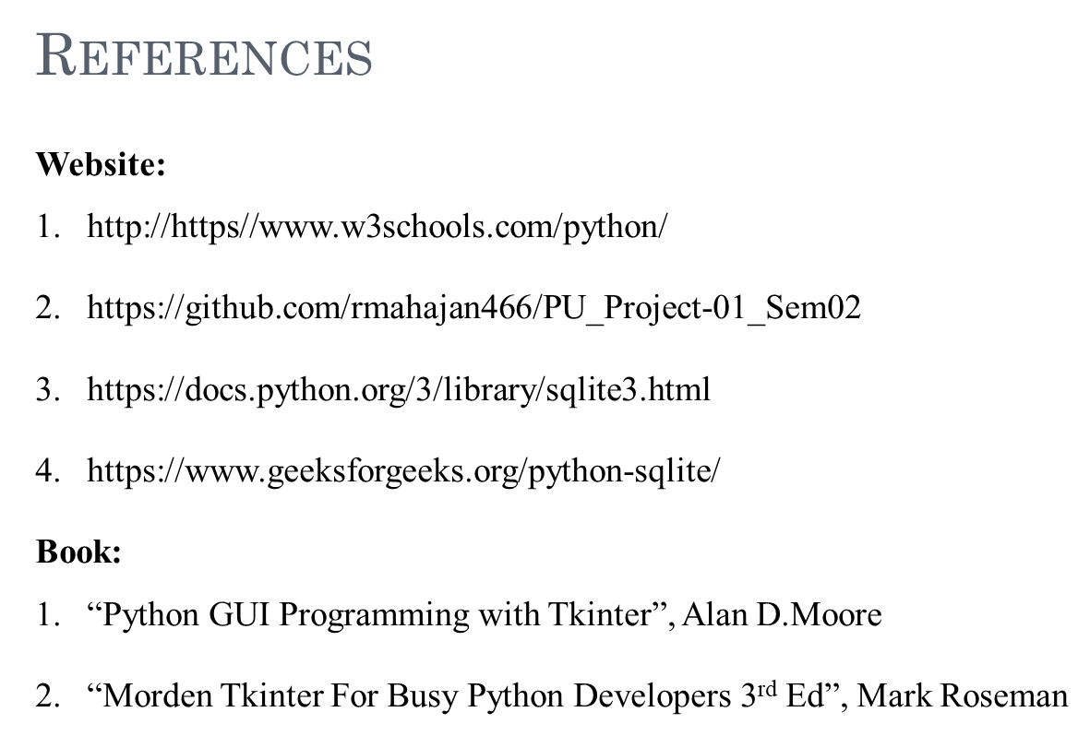

Slide 10
Thank You

